Slide 1
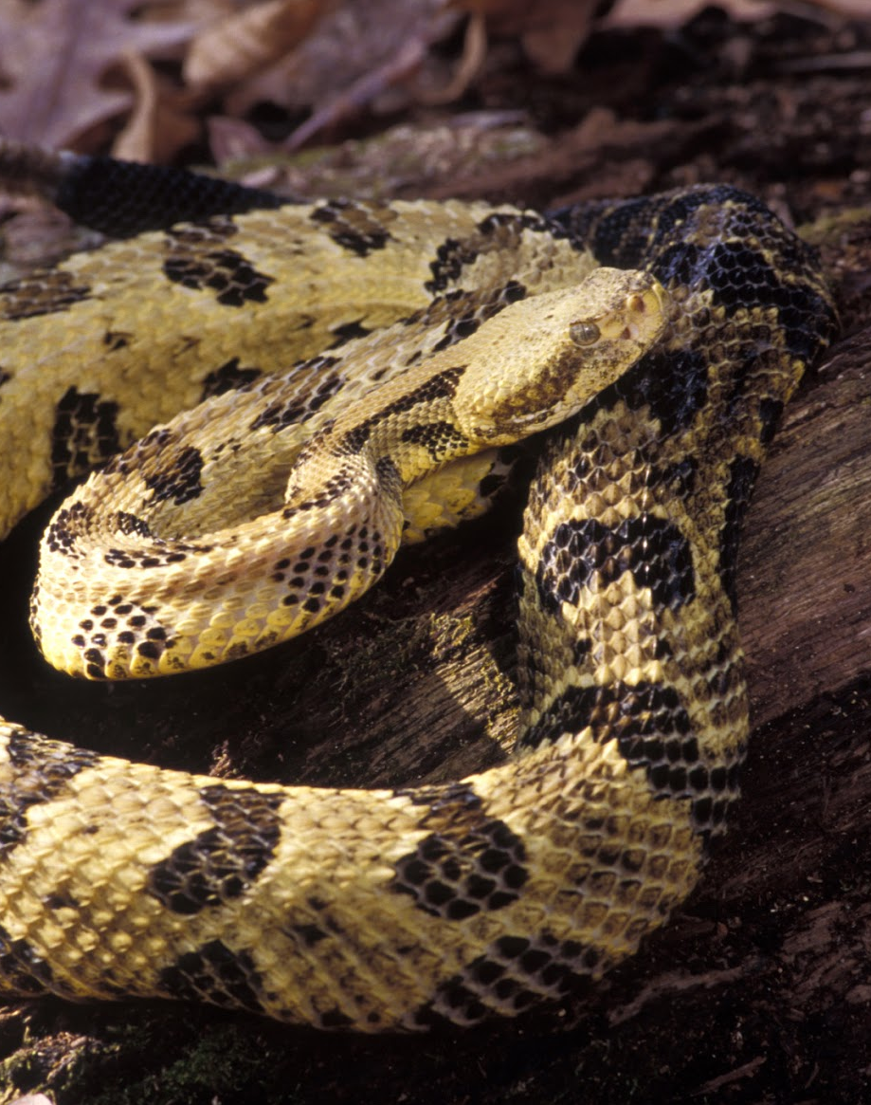
Timber Rattlesnakes
Casey Turkosz, Bryan Hidalgo,
Tannar Cliffe, Joshua White,
Charlotte Paucar

Slide 2
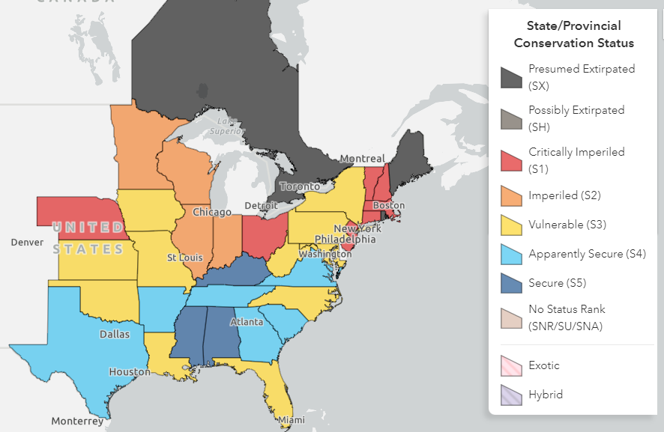
Introduction
Crotalus horridus = “horrible rattler”
Largest (venomous) snake in NY; record length of 1.892 m (6.21 ft). (Brown et al. 2014)
Considered threatened in New York, but federally not listed as endangered (NYS DEC 2007) (Hammerson 2007)
Is recovery possible with current conservation efforts?
Is it possible to get people on board with saving a large, venomous and “scary” snake?
(credit: NatureServe)

Slide 3
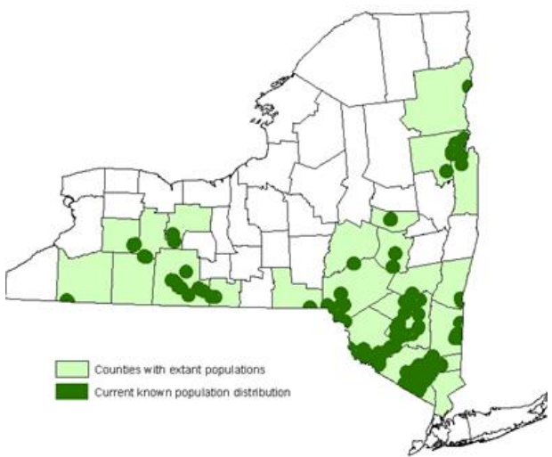
Background
Habitat: mountainous forests (high elevation), rocky outcroppings, hardwood forests, swamps, agricultural fields (NYS DEC 2013)
Hibernate in dens, often with other snakes (Knight 2021)
Have a number of predators from coyotes to turkeys
(credit: NYSDEC)

Slide 4
Historic Decline
Extirpated from Long Island, New York City, parts of western New York, the Adirondacks, and Catskill Mountains, with overall population loss statewide estimated at 60% (NYS Dept. of Environmental Conservation 2007)
“The number of these hideous reptiles would be greatly reduced by the offer and payment of a reasonable bounty for their destruction. Indeed, the extermination of venomous serpents throughout the country would be actively promoted by the establishment of such a bounty system in every State.” (“A Bounty On Rattlesnakes” 1882)
Bounties outlawed in 1971, but indiscriminate and purposeful persecution was (and is) a constant issue (NYS Dept. of Environmental Conservation 2007)

Slide 5
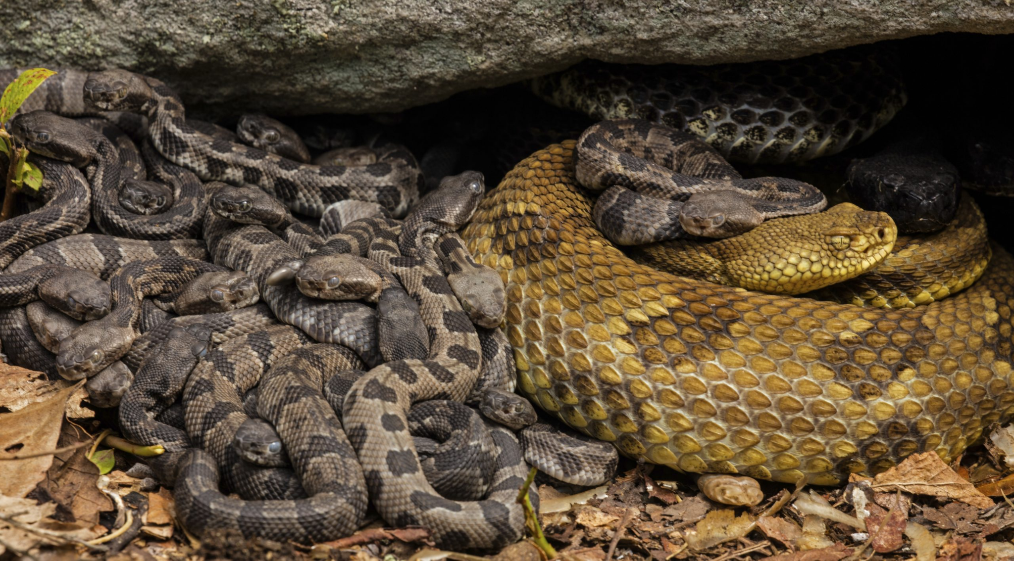
Complications with Recovery
Public View
Decreasing Habitat
K-Selected
(credit: John Cancalosi)
Notes:
Threats
Come together to birth young (up to 20)
Slow Reproduction (Reproduce every 3 year)
9 young every 3-5 years
High mortality rate when young
Mature between 5-11 years old
People are scared
There was a bounty in the NY until 1971
Deforestation

Slide 6
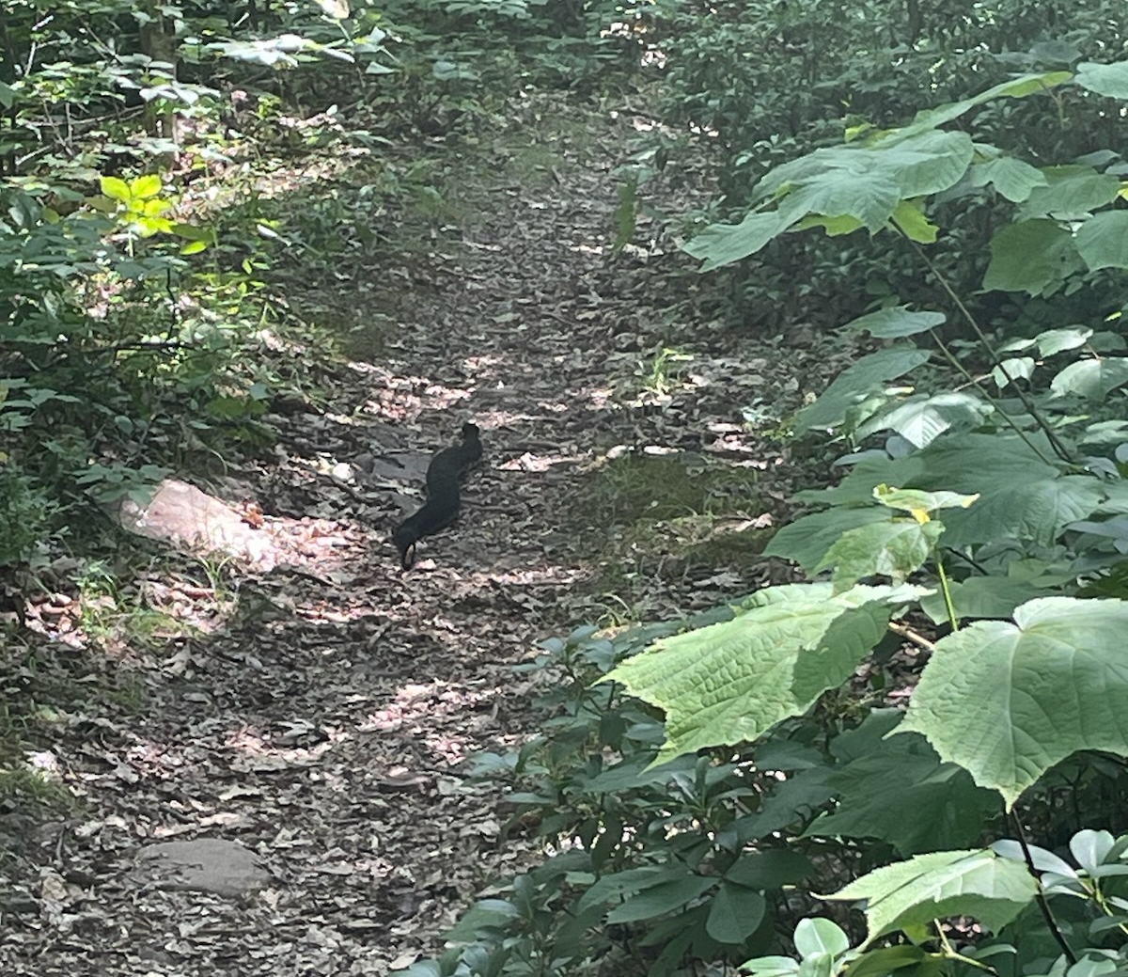
Conclusion
The current conservation efforts placed for timber rattlesnakes are legal protection from poachers or hunters and the protection of areas surrounding dens
If the populations remain under active protection this way, recovery is possible. However it won’t be anywhere near historic numbers
“Recovery might just to me mean self supporting populations on into the future” -Glenn Johnson (department chair of biology SUNY Potsdam) (Johnson 2022)
Timber rattlesnakes bring an important role towards their ecosystem and provide a lower occurrence of lyme disease
(credit: Joshua White)
Notes:
Local education where the populations are via scientists, schools

Slide 7
Citations
Ann Arbor Democrat. 1882. A Bounty On Rattlesnakes. Ann Arbor, Michigan.
https://aadl.org/node/411585
Brown, W. S., N. P., and G. A. Hammerson. 2014. Crotalus horridus, NatureServe Explorer. https://explorer.natureserve.org/Taxon/ELEMENT_GLOBAL.2.100455/Crotalus_horridus.
Hammerson, G. A. 2007. Crotalus horridus. IUCN Red List of Threatened Species. https://www.iucnredlist.org/species/64318/12765920.
Knight, S. 2021. Are You My Mother? https://www.biographic.com/are-you-my-mother/
NYS DEC. 2013. Species Assessment for Timber rattlesnake. https://www.dec.ny.gov/docs/wildlife_pdf/sgcntimberrattlesnak.pdf.
NYS Dept. of Environmental Conservation. 2007. Timber Rattlesnake. https://www.dec.ny.gov/animals/7147.html.

